Slide 1
IOT ENABLED RISK MONITORING SYSTEM
IN COLD SUPPLY CHAIN
UDHAYA KUMAR R (201EC276)
SIVASENTHIL D (201EC255)
JAGAN T M (201EC162)
SASIVARNAM J (201EC246)

Slide 2
Abstract
Cold storage refers to refrigerated or frozen storage facilities.
Cold stores can be used in rooms, homes, supermarkets, and warehouses
for a variety of purposes such as storing foods, pharmaceuticals and medicines, ambient products, chilled products, and frozen products.
Cold storage facilities carry all the same potential dangers as a standard warehouse, as well as a few special risks and fire hazards that have to be dealt with.
Risk assessment shows the kind of approach a cold storage warehousing might take.
There is problem due to leakage of ammonia, hazardous gases which may leads to many disasters in the warehouse.

Slide 3
Problem Statement Addressed
In the cold storage area( -70 to +60 degree Celsius) we are facing maximum number of problems because of leakage of ammonia which is used instead of CFC , to produce more efficiency but it more harmful to humans and living creatures. Electronics used in the cold storage is getting damage due to the increase in the moisture level and the fire incidents is taking place frequently. However it is in the large commercial places , the cold storage can be transmitted from one area to another area it should be monitored..

Slide 4
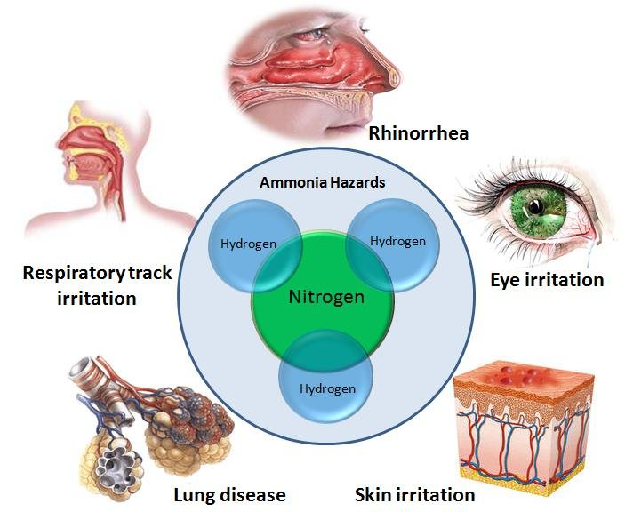
Existing Solution to the Problem Addressed
PROBLEM DUE TO AMMONIA:
From 1996 to 2011, there were 939 accidents at these plants—an average of more than one a week. The accidents, not all of which involved anhydrous ammonia releases, resulted in 19 deaths, 1,651 injuries, and almost $350 million in property damage.

Slide 5
Proposed Solution to the Problem Addressed
Ammonia is a most harmful gas which may cause a problem to a human , there may be chance of getting death.
If the leakage of ammonia occurs in the cold storage, the MQ137 gas sensor which is specially used for the detection of ammonia (1 to 500 ppm) detects it makes the doors and shutter to get open.
The next level of problem is rising of the humidity level(50% RH to 95%RH) , if it is gets increasing , the sensor sends the indication via buzzer. The damage of electronics gets stopped.
The fire incidents may be solved by the insulated metal panels and Type –k thermocouple(-200 to +1400 degree Celsius).
The tracking of moveable cold storage can be done through GPS systems. The data of any cold storage can be monitored from anyplace around the world.

Slide 6
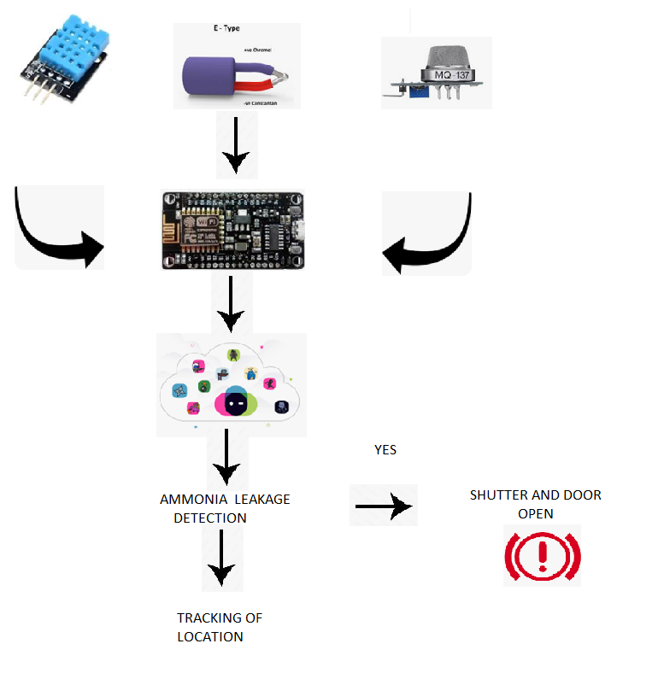
Flow Chart

Slide 7
Effective utilization of the Modern Tool & Cloud
IOT BASED MONITORING SYSTEM
OF COLD STORAGE:
Agriculture industry
Blood banks
Food & beverage industry
Healthcare industry
Pharmaceutical facilities
Restaurant chains
Food manufacturing facilities

Slide 8
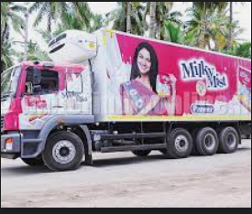
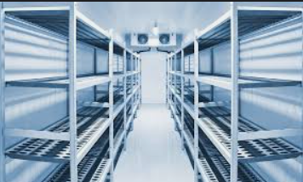
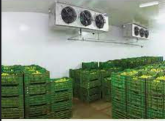
Technology stack & use case
People are safeguarded from
ammonia leakage
Firing in industries controlled
Discharge of gases from ripened
fruits is controlled.
Electronic damage can be
controlled.
Tracking of location is done

Slide 9
Analysis of Results & Discussions
For escape in an emergency, cold storage rooms should have at least one door that opens from the inside
Lighting must be supplied through a constantly burning bulb or a light with an illuminated switch located inside the cold room.
Non-slip flooring mats protect workers in wet areas
If anti-freeze doors are not installed in at the cold storage workplace, ensure that a firefighter’s axe is stored in the room.
Items in cold storage are often valuable and require security.
Doors at the worksite must have inside and outside locking mechanism

Slide 10
Cost Benefit Analysis (List of Components / Service Used)
(Budget)
S.No | Component Name | Specification (IC number or Range or Value) | Unit Cost | Total Cost

